Slide 1
Laboratory project
Biomolecular Modelling Laboratory 2022
Team 5: Cecilia Di Gennaro, Mila Langone and Francesca Vagnozzi

Slide 2
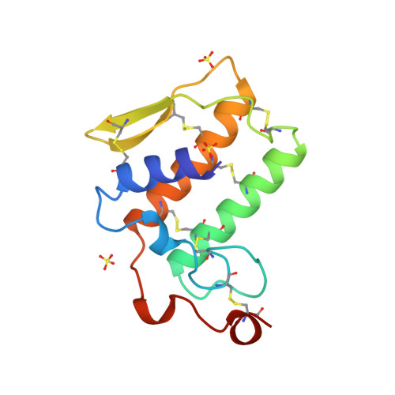
Notexin (1AE7)
Single-peptide chain
119 AAs
7 disulfide-bridges
4 main helices: αA, αB, αC and αE

Slide 3
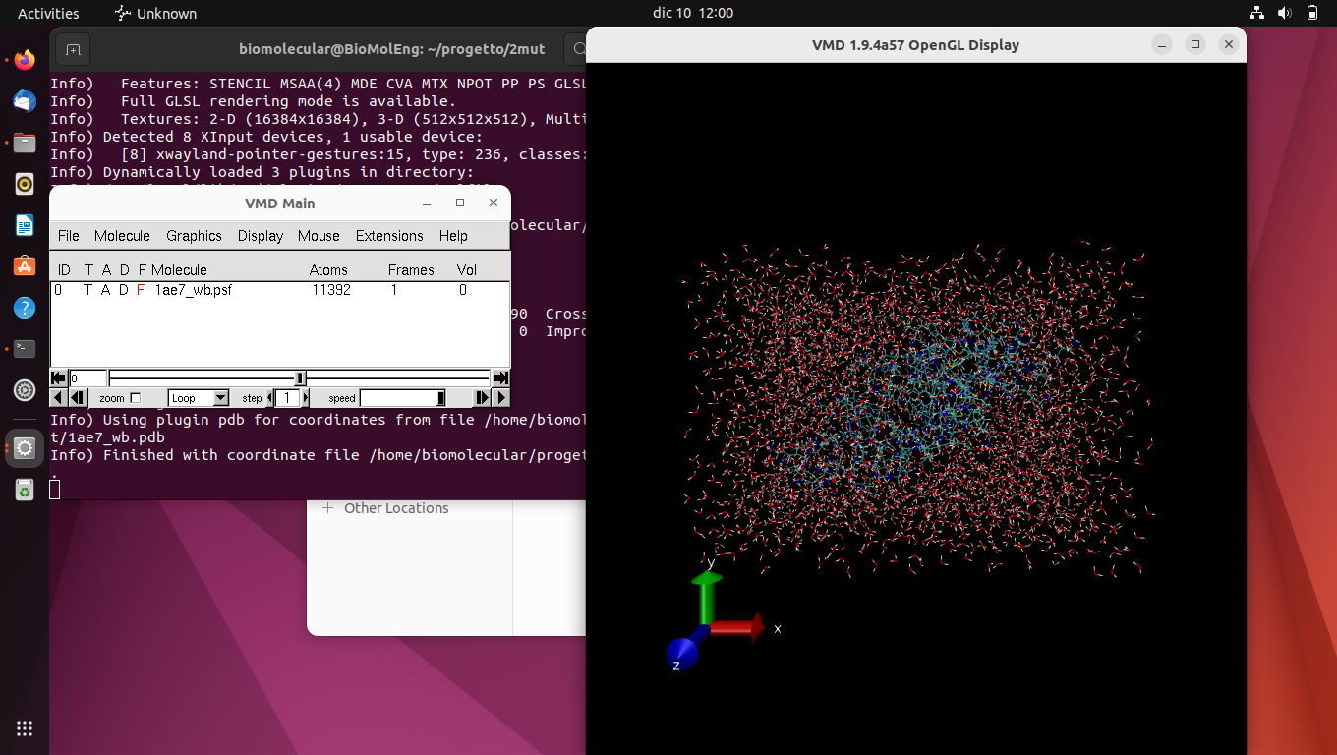
SOLVATION
Solvate the protein in an explicit solvent
Introduce the protein in a water box with periodic boundary conditions
Create a ionized version

Slide 4
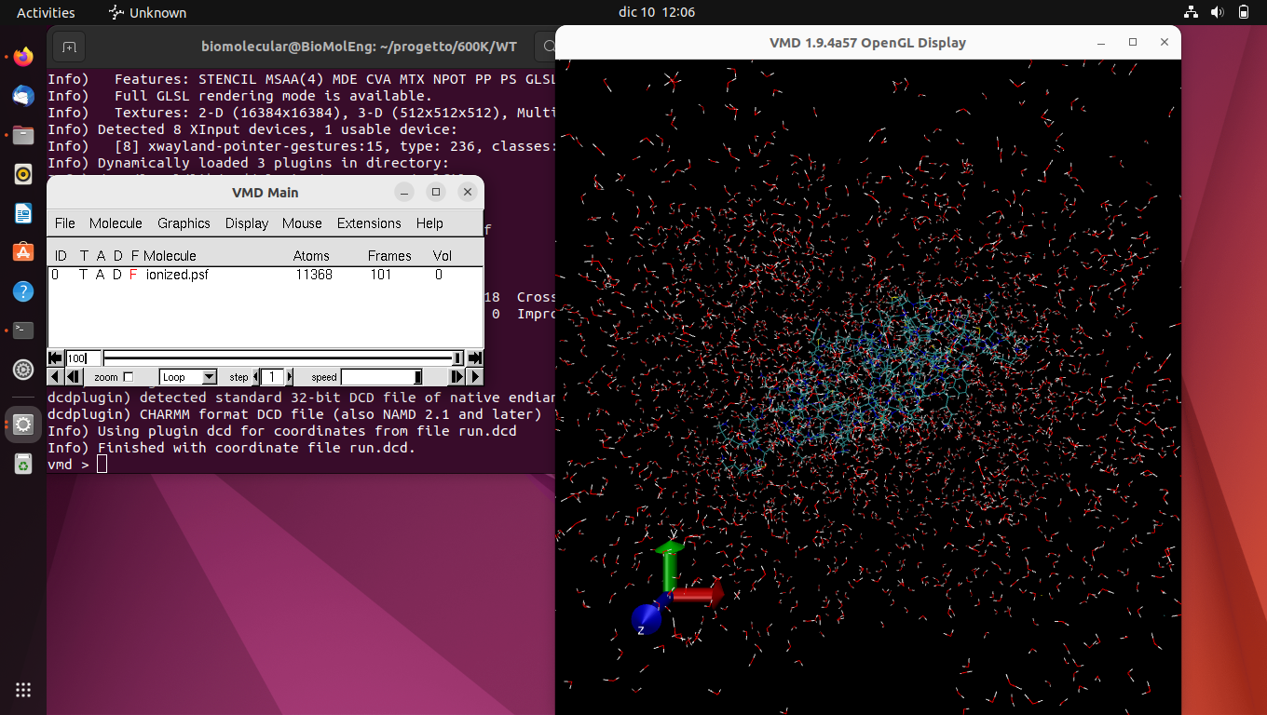
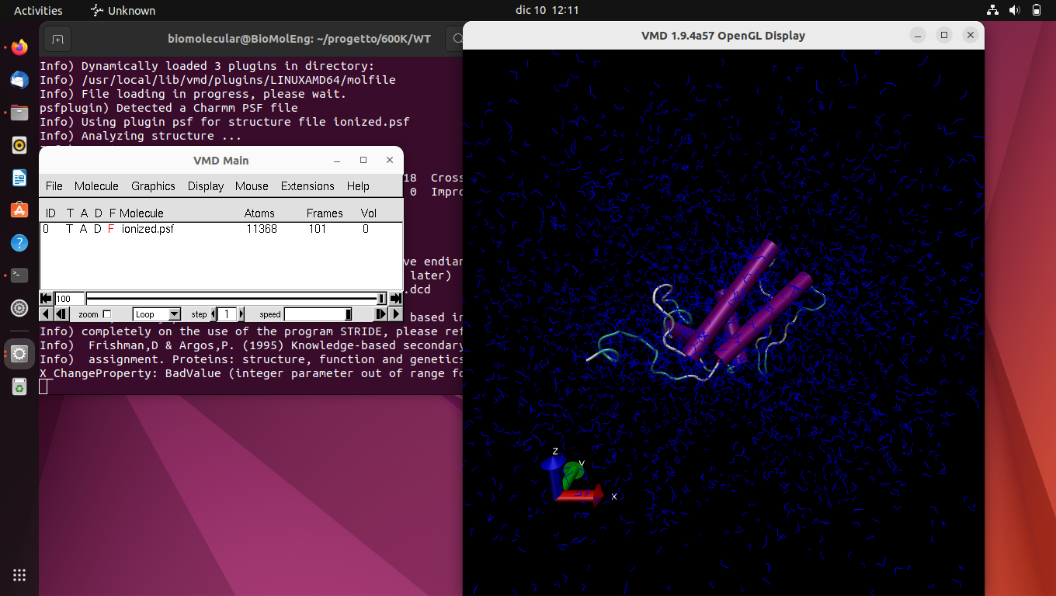
SIMULATION PARAMETERS
T=600K
time=100ns
frames=1ns
Center=22; 25; 41.
WB size=5 Å
# steps= 10000

Slide 5
METHODOLOGY
1
2
3
4
5
Two simulations of the wild-type protein with 4 different temperatures: 310K, 400K, 500K, 600K
Selection of the temperature with less native contacts
Comparison between RMSF and the secondary structure to identify the most unstable regions
Construction of protein variants using Foldx and choice of the best one.
Run the simulation again with the mutate protein and check the native contacts (Q-value)

Slide 6
TEMPERATURE SELECTION
Temperature [K] | Mean Native Contacts [%]
310 | 96
400 | 94
500 | 89
600 | 86
*Mean native contacts between the last 10 frames of the simulation

Slide 7
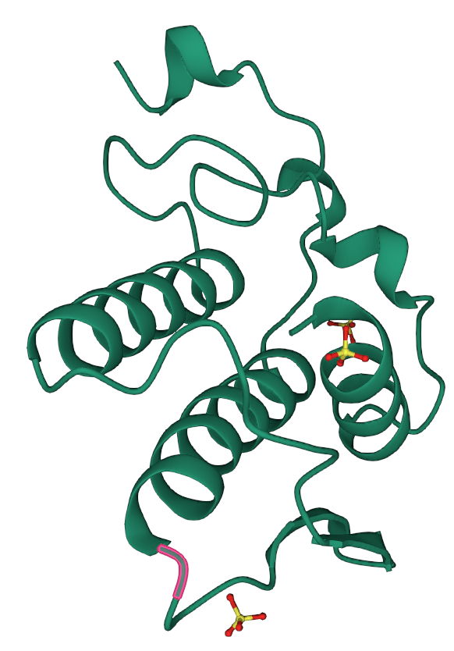
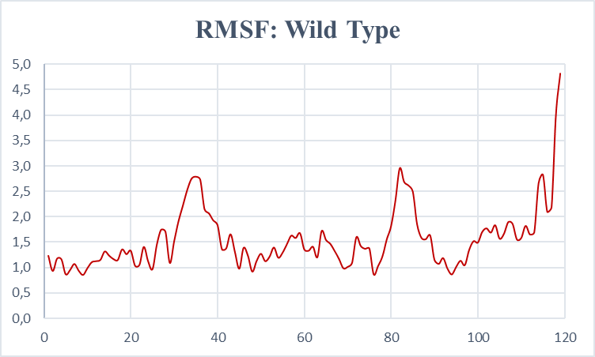
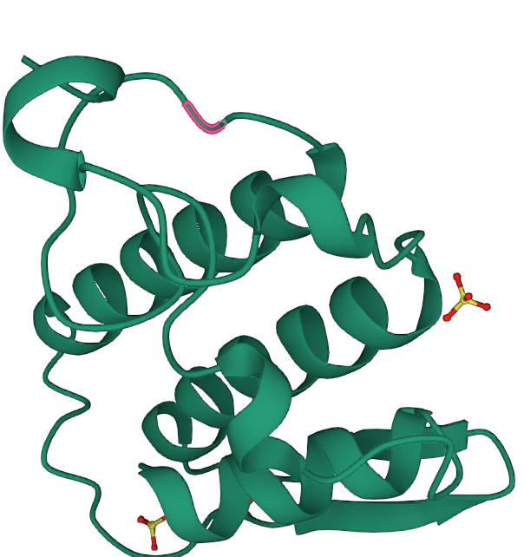
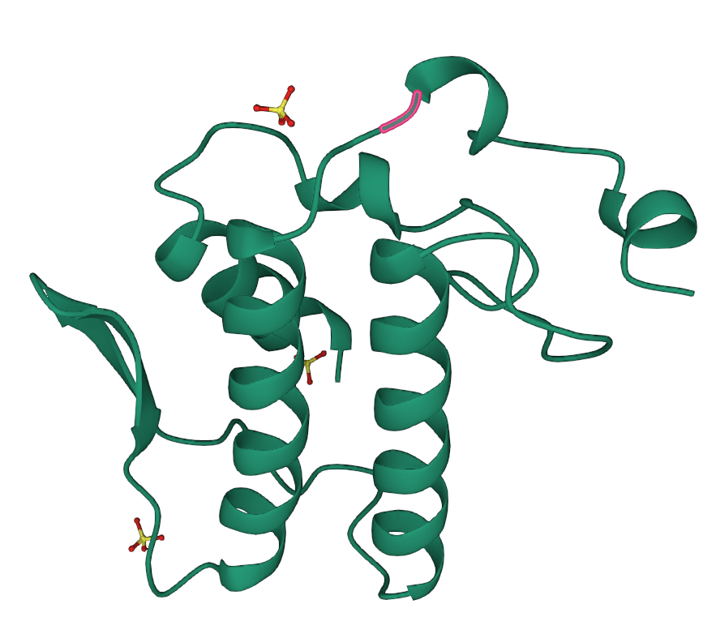
RMSF AND SECONDARY STRUCTURE
89
37
112
Notes:
Just talk about PW3

Slide 8
FOLDX
LOOP REGION | MUTATION WITH NEGATIVE VALUES | POSSIBLE MUTATIONS
14-18 | 🗙 | 🗙
23-29 | 🗙 | 🗙
30-39 | 🗙 | 🗙
61-74 | ✔ | 69 LYS→LEU 69 LYS→MET
85-89 | ✔ | 89 LYS→ASP
109-112 | ✔ | 112 ASP →TYR

Slide 9
RESULTS
Variant | Energy output | Mean Q-value* | SD Q-value*
WT | - | 0,866 | 0,0149
69 MET | -2,31687 | 0,823 | 0,0159
69 LEU | -2,04749 | 0,817 | 0,0088
89 ASP | -3.3399 | 0,821 | 0,0132
112 TYR | -2,1491 | 0,849 | 0,0181
69 MET & 112 TYR | - | 0,811 | 0,0134
69 MET & 89 ASP & 112 TYR | - | 0,821 | 0,0108
*Mean and SD between the last 10 frames of the simulation

Slide 10
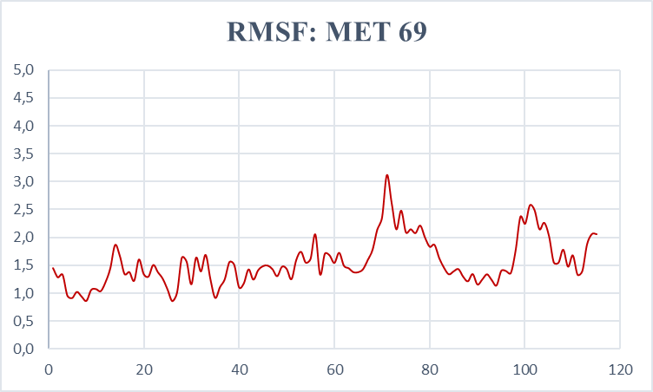
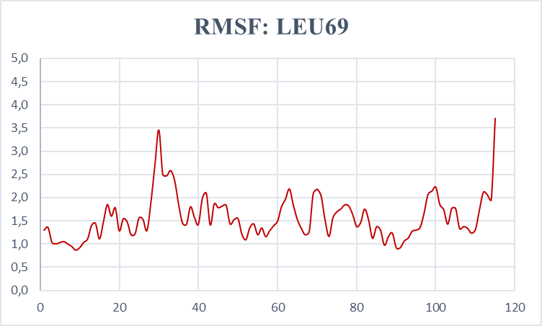
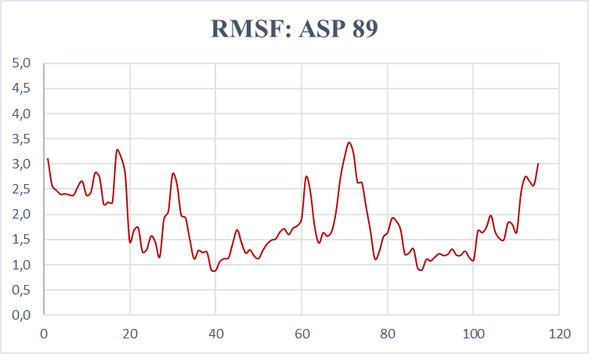
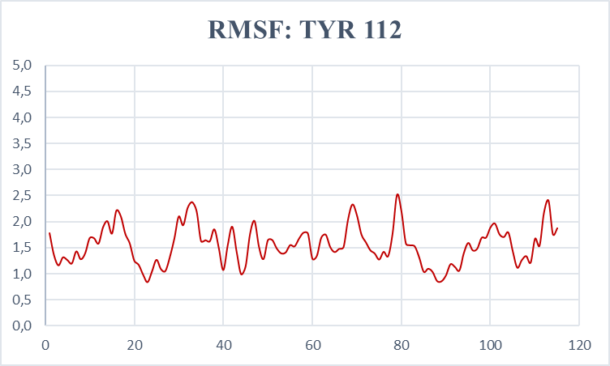

Slide 11
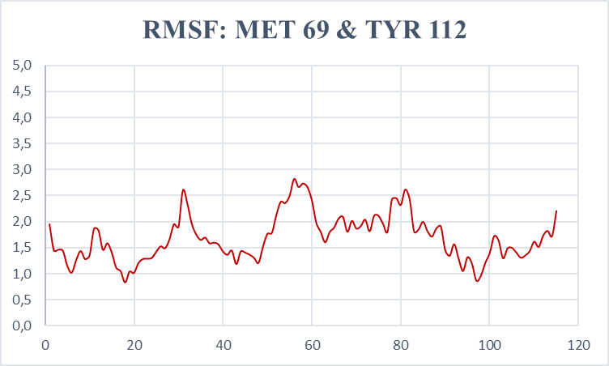
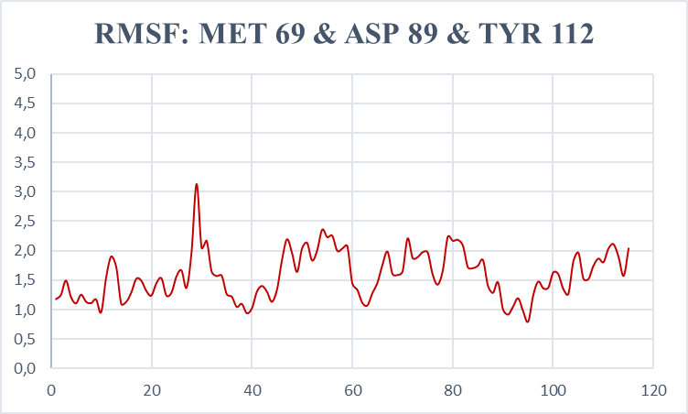

Slide 12
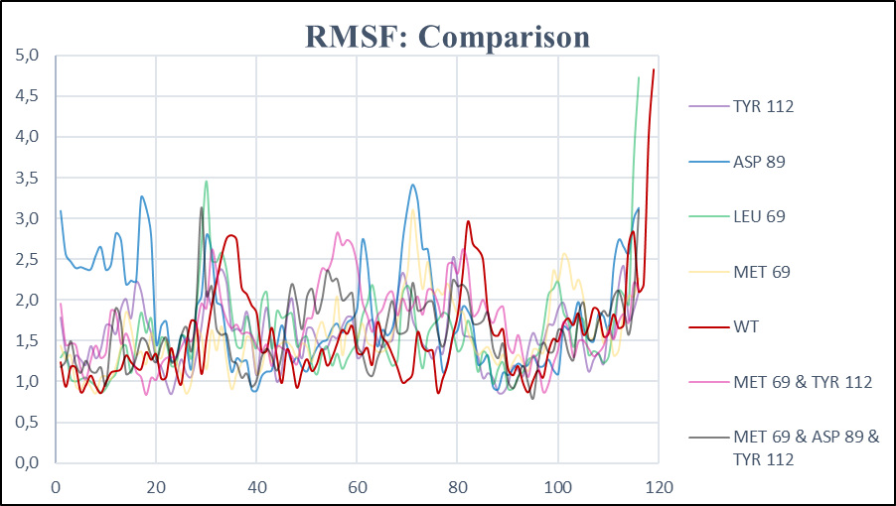

Slide 13
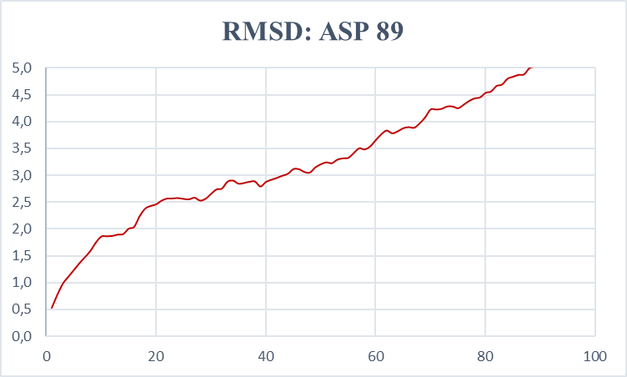
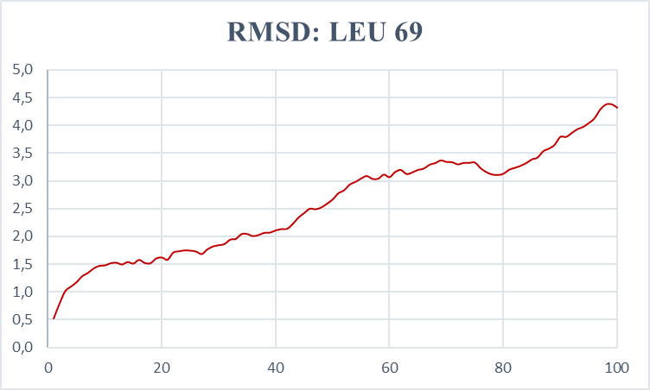
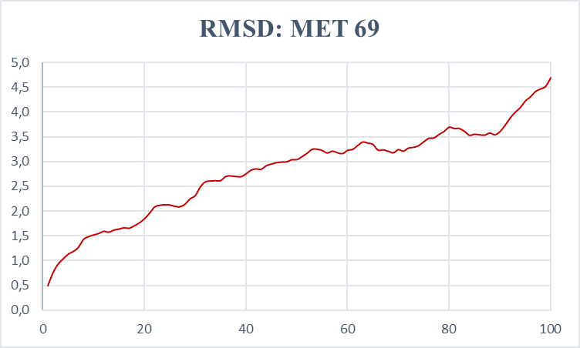
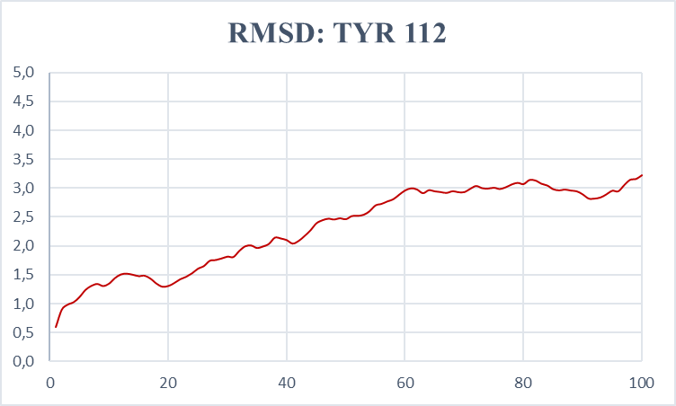

Slide 14
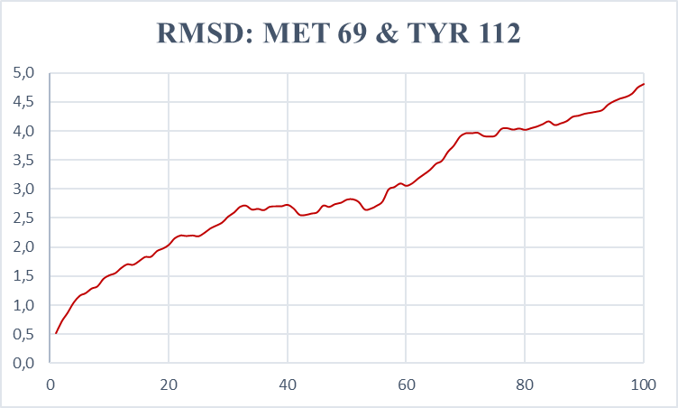
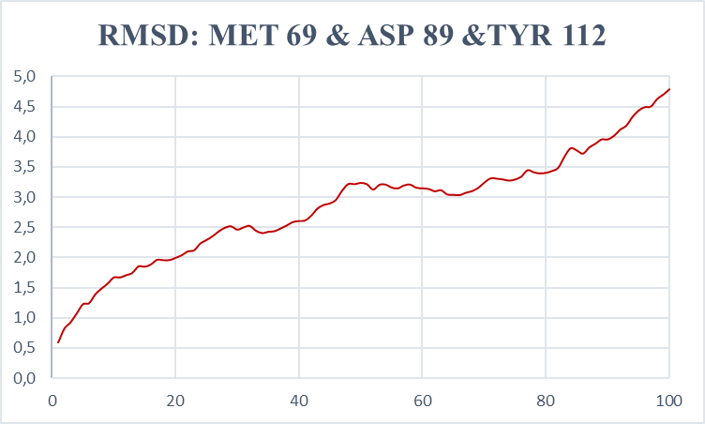

Slide 15
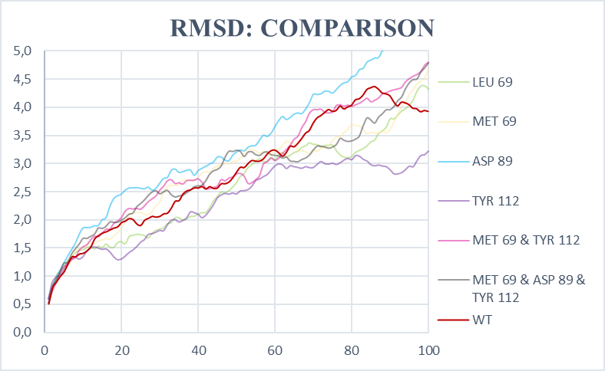

Slide 16
RMSD
VARIANT | Average | SD
WT | 2,853 | 1,022
69 MET | 2,824 | 0,913
69 LEU | 2,586 | 0,929
89 ASP | 3,391 | 1,263
112 TYR | 2,317 | 0,711
69 MET & 112 TYR | 2,959 | 1,05
69 MET & 89 ASP & 112 TYR | 2,670 | 0,829

Slide 17
STABILITY
VARIANT | TOTAL ENERGY
WT | 15,79
69 MET | 9,35
69 LEU | 9,62
89 ASP | 11,27
112 TYR | 11,38
69 MET & 112 TYR | 3,80
69 MET & 89 ASP & 112 TYR | -1,10

Slide 18

POSSIBLE IMPROVEMENTS
Increase simulation time or steps
Increase temperature
Different solvation method
Combination of mutations
Set numberOfRuns to higher numbers: optimal or trapped solution
Notes:
Increase simulation time
Different solvation method
Increase temperature
Combination of mutations
Set numberOfRuns to higher numbers: optimal or trapped solution.

Slide 19
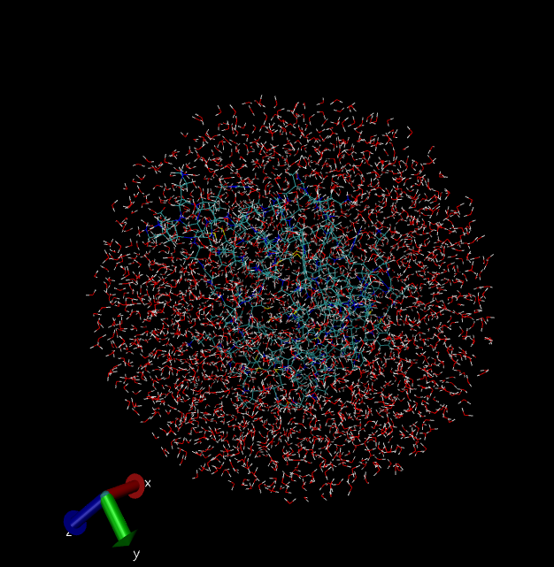
WATER SPHERE
Variant | Mean Q-Value | SD
WT | 0,84943363 | 0,01014880
69 & 89 & 112 | 0,72172545 | 0,03017851

Slide 20
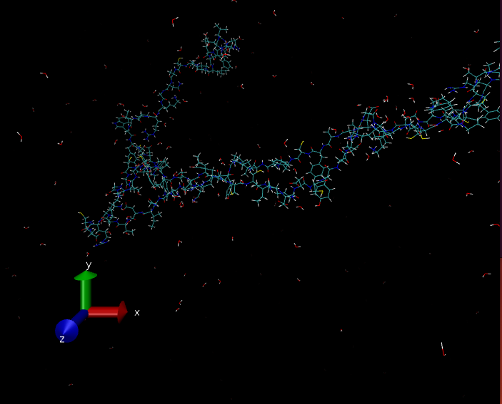
Increase simulation steps
From 10 000 to 50 000 steps
VARIANT | Mean Q-value | SD
WT | 0,5313 | 0,00749
69 & 89 & 112 | 0,6016 | 0,00748
*Mean and SD between the last 50 frames of the simulation

Slide 21
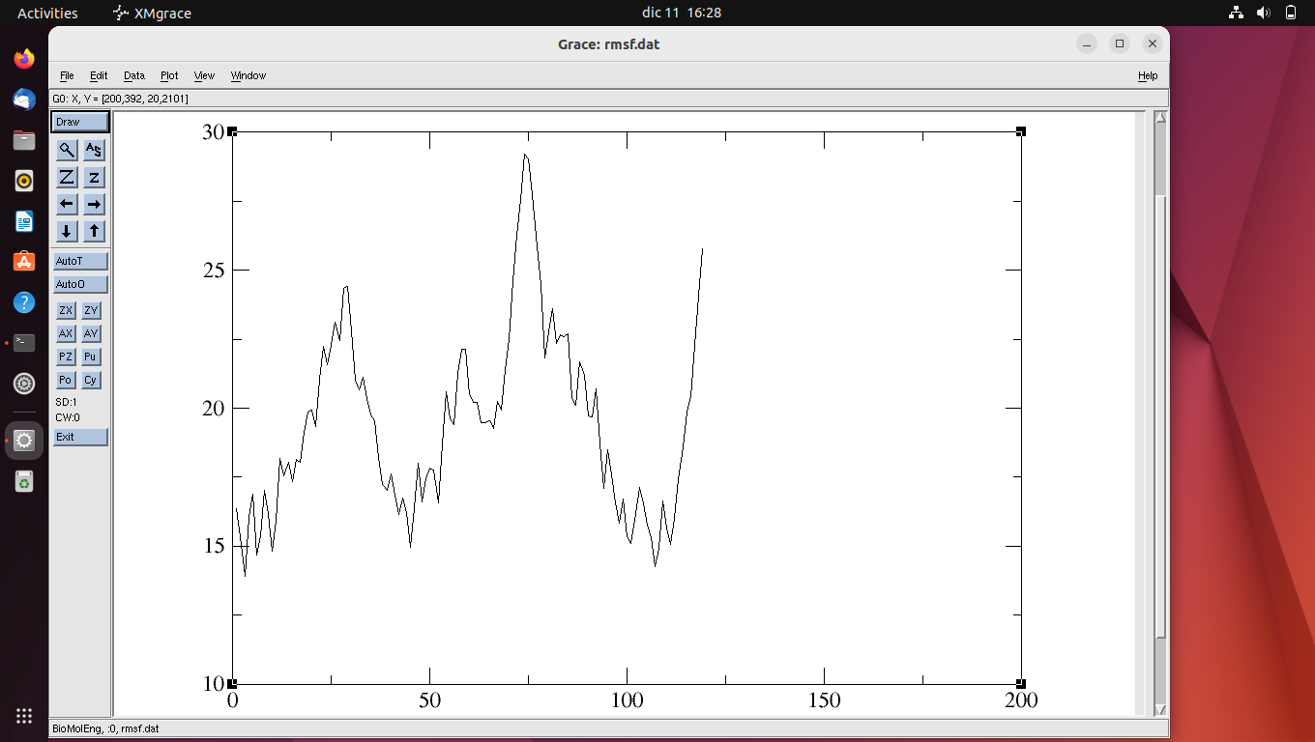
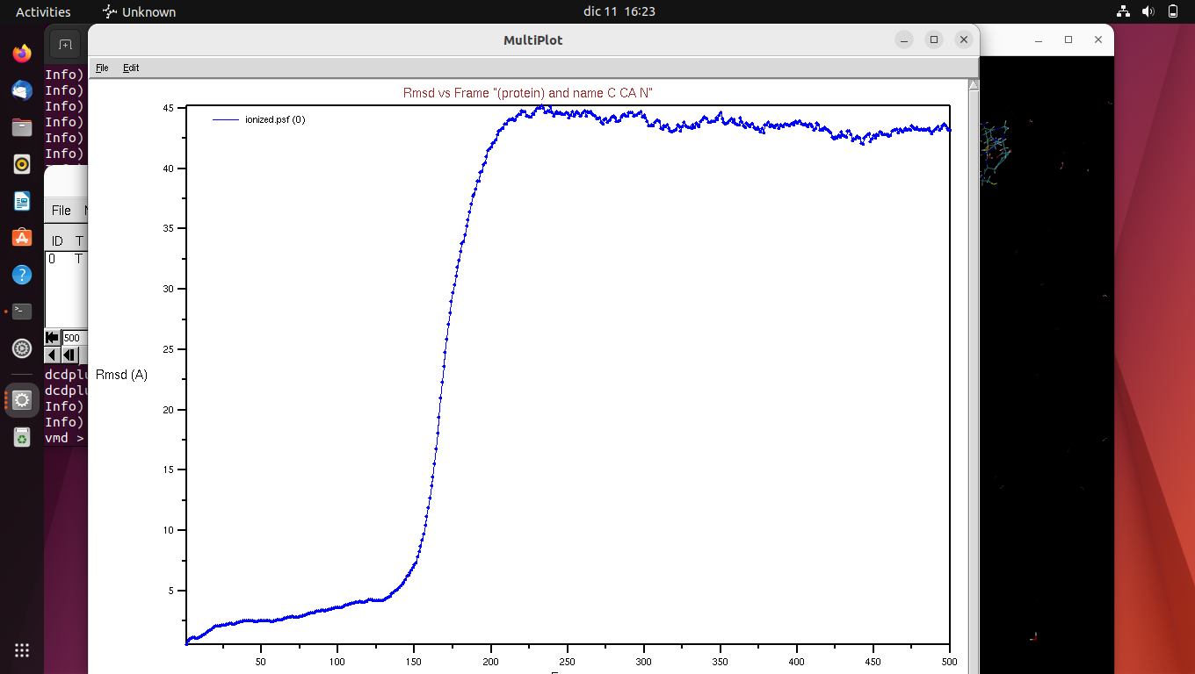
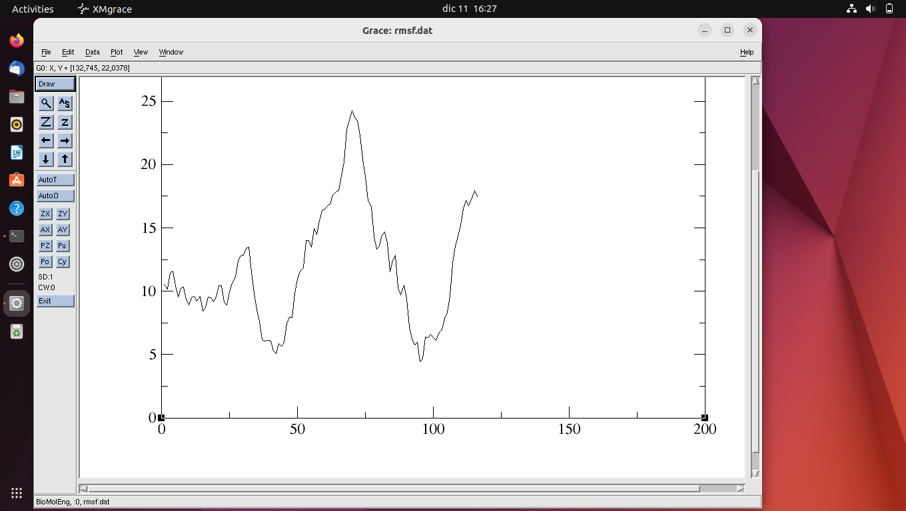
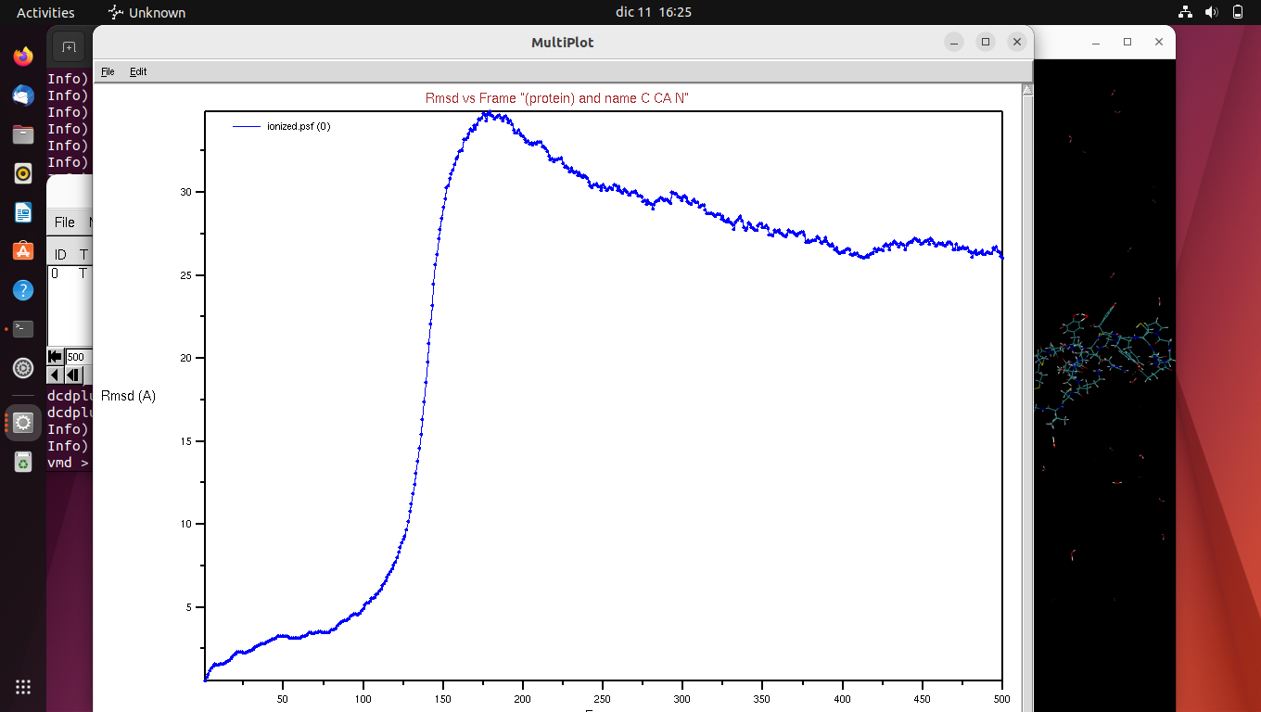
CONCLUSIONS
RMSF:
RMSD:
WT
Mutate

Slide 22
THANK YOU FOR YOUR ATTENTION
Do you have any questions?

Slide 23
BIBLIOGRAPHY
Phillips, J.,Hardy, D. (2017). NAMD TUTORIAL.Tutorials (uiuc.edu)
Westerlund, B., Nordlund, P. (1997), Notexin, A presynaptic neurotoxic phospholipase A2 doi: 10.2210/pdb1AE7/pdb

